Slide 1
Deadlocks

Slide 2
Chapter Objectives
To develop a description of deadlocks, which prevent sets of concurrent processes from completing their tasks
To present a number of different methods for preventing or avoiding deadlocks in a computer system

Slide 3
The Deadlock Problem
A set of blocked processes each holding a resource and waiting to acquire a resource held by another process in the set
Example
System has 2 disk drives
P₁ and P₂ each hold one disk drive and each needs another one
Example
semaphores A and B, initialized to 1 P₀ P₁
wait (A); wait(B)
wait (B); wait(A)

Slide 4
Bridge Crossing Example
Traffic only in one direction
Each section of a bridge can be viewed as a resource
If a deadlock occurs, it can be resolved if one car backs up (preempt resources and rollback)
Several cars may have to be backed up if a deadlock occurs
Starvation is possible

Slide 5
System Model
Resource types R₁, R₂, . . ., R_{m}
CPU cycles, memory space, I/O devices
Each resource type R_{i} has W_{i} instances.
Each process utilizes a resource as follows:
request
use
release

Slide 6
Deadlock Characterization
Deadlock can arise if four conditions hold simultaneously.
Mutual exclusion: At least one resource must be held in a non sharable mode; that is, only one process at a time can use a resource
Hold and wait: A process must be holding at least one resource and waiting to acquire additional resources that are currently being held by other processes

Slide 7
No preemption: Resources cannot be preempted; a resource can be released only voluntarily by the process holding it, after that process has completed its task
Circular wait: A set {P₀, P₁, …, P_{n}} of waiting processes must exist such that
P₀ is waiting for a resource that is held by P₁,
P₁ is waiting for a resource that is held by P₂, …,
P_{n–1} is waiting for a resource that is held by P_{n},
and P_{n} is waiting for a resource that is held by P₀.

Slide 8
Resource-Allocation Graph
A set of vertices V and a set of edges E.
V is partitioned into two types:
P = {P₁, P₂, …, P_{n}}, the set consisting of all the processes in the system
R = {R₁, R₂, …, R_{m}}, the set consisting of all resource types in the system
request edge – directed edge P_{i} → R_{j}
assignment edge – directed edge R_{j} → P_{i}

Slide 9
Resource-Allocation Graph (Cont.)
Process
Resource Type with 4 instances
P_{i} requests instance of R_{j}
P_{i} is holding an instance of R_{j}
P_{i}
R_{j}
P_{i}
R_{j}

Slide 10
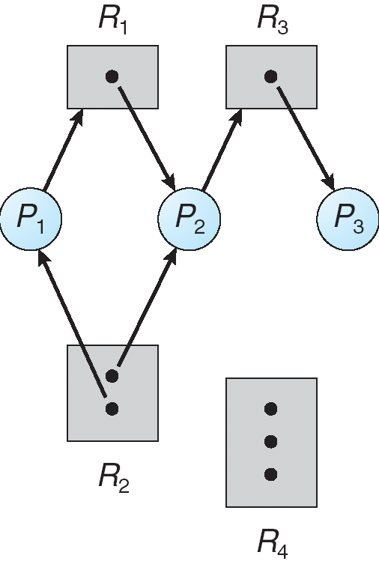
Example of a Resource Allocation Graph

Slide 11
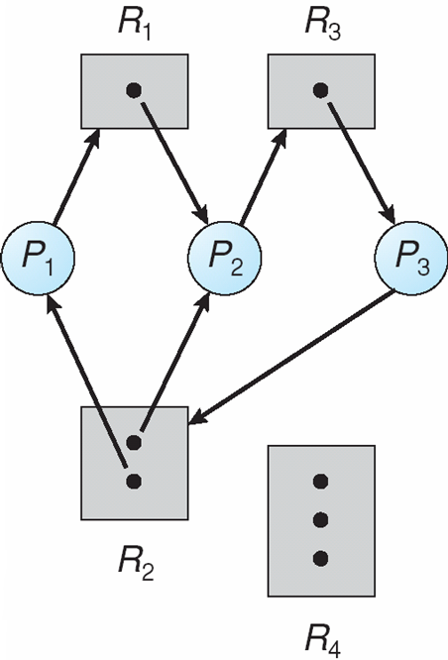
Resource Allocation Graph With A Deadlock

Slide 12
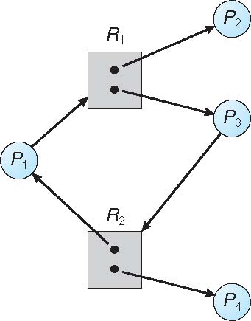
Graph With A Cycle But No Deadlock

Slide 13
Basic Facts
If graph contains no cycles ⇒ no deadlock
If graph contains a cycle ⇒
if only one instance per resource type, then deadlock
if several instances per resource type, possibility of deadlock

Slide 14
Methods for Handling Deadlocks
Ensure that the system will never enter a deadlock state – deadlock prevention
Allow the system to enter a deadlocked state, detect it and then recover
Ignore the problem and pretend that deadlocks never occur in the system; used by most operating systems, including UNIX and windows

Slide 15
Deadlock Prevention
Restrain the ways request can be made
Mutual Exclusion – not required for sharable resources; must hold for non-sharable resources
Hold and Wait – must guarantee that whenever a process requests a resource, it does not hold any other resources
Require process to request and be allocated all its resources before it begins execution, or allow process to request resources only when the process has none
Low resource utilization; starvation possible

Slide 16
Deadlock Prevention (Cont.)
No Preemption –
If a process that is holding some resources requests another resource that cannot be immediately allocated to it, then all resources currently being held are released
Preempted resources are added to the list of resources for which the process is waiting
Process will be restarted only when it can regain its old resources, as well as the new ones that it is requesting

Slide 17
Alternatively, If a process requests some resources , we check whether they are available
If yes, we allocate them
If no, check whether they are allocated to some other process that is waiting for additional resources
If so, we preempt the resources from waiting process and allocate
If resources are neither available nor held by a waiting process, the requesting process must wait

Slide 18
Circular Wait – impose a total ordering of all resource types, and to require that each process requests resources in an increasing order of enumeration

Slide 19
Deadlock Avoidance
Requires that the system has some additional a priori information
available
Simplest and most useful model requires that each process declare the maximum number of resources of each type that it may need
The deadlock-avoidance algorithm dynamically examines the resource-allocation state to ensure that there can never be a circular-wait condition
Resource-allocation state is defined by the number of available and allocated resources, and the maximum demands of the processes

Slide 20
Safe State
When a process requests an available resource, system must decide if immediate allocation leaves the system in a safe state
System is in safe state if there exists a sequence <P₁, P₂, …, P_{n}> of ALL the processes is the systems such that for each P_{i}, the resources that P_{i} can still request can be satisfied by currently available resources + resources held by all the P_{j}, with j < I
That is:
If P_{i} resource needs are not immediately available, then P_{i} can wait until all P_{j} have finished
When P_{j} is finished, P_{i} can obtain needed resources, execute, return allocated resources, and terminate
When P_{i} terminates, P_{i +1} can obtain its needed resources, and so on

Slide 21
Basic Facts
If a system is in safe state ⇒ no deadlocks
If a system is in unsafe state ⇒ possibility of deadlock
Avoidance ⇒ ensure that a system will never enter an unsafe state.

Slide 22
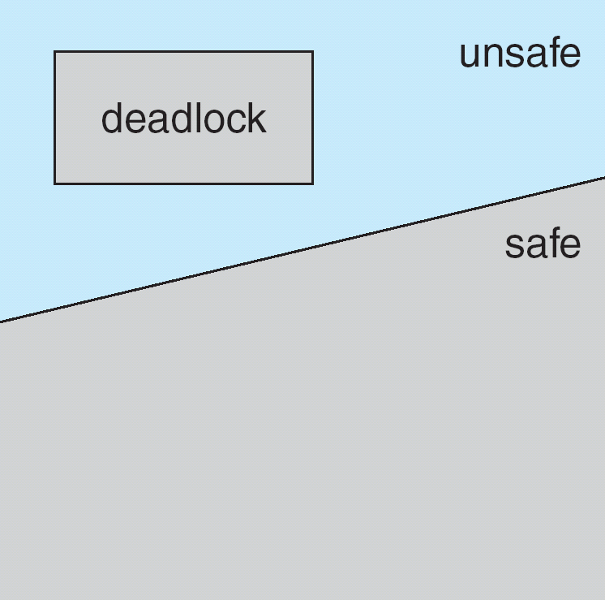
Safe, Unsafe, Deadlock State

Slide 23
Avoidance algorithms
Single instance of a resource type
Use a resource-allocation graph
Multiple instances of a resource type
Use the banker’s algorithm

Slide 24
Resource-Allocation Graph Scheme
Claim edge P_{i} → R_{j} indicated that process P_{j} may request resource R_{j}; represented by a dashed line
Claim edge converts to request edge when a process requests a resource
Request edge converted to an assignment edge when the resource is allocated to the process
When a resource is released by a process, assignment edge reconverts to a claim edge
Resources must be claimed a priori in the system

Slide 25
Resource-Allocation Graph Algorithm
Suppose process P_{i} requests a resource R_{j}
The request can be granted only if converting the request edge to an assignment edge does not result in the formation of a cycle in the resource allocation graph

Slide 26
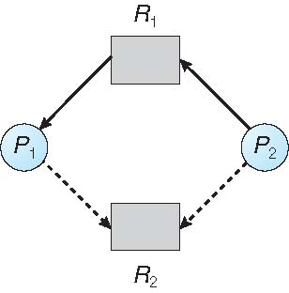
Resource-Allocation Graph
Suppose P2 requests R2. Although R2 is free, cant be allocated to P2, as this action will create a cycle in the graph.
A cycle indicates that the system is in an unsafe state.
If P1 requests R2 and P2 requests R1, then a deadlock will occur

Slide 27
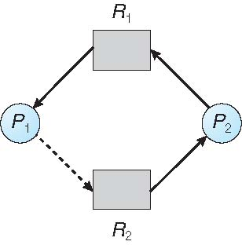
Unsafe State In Resource-Allocation Graph

Slide 28
Banker’s Algorithm
Multiple instances
Each process must a priori claim maximum use
When a process requests a resource it may have to wait
When a process gets all its resources it must return them in a finite amount of time

Slide 29
Data Structures for the Banker’s Algorithm
Let n = number of processes, and m = number of resources types.
Available: Vector of length m. If available [j] = k, there are k instances of resource type R_{j} available
Max: n x m matrix. If Max [i,j] = k, then process P_{i} may request at most k instances of resource type R_{j}
Allocation: n x m matrix. If Allocation[i,j] = k then P_{i} is currently allocated k instances of R_{j}
Need: n x m matrix. If Need[i,j] = k, then P_{i} may need k more instances of R_{j} to complete its task Need [i,j] = Max[i,j] – Allocation [i,j]

Slide 30
Safety Algorithm
Let Current_Avail and Marked be vectors of length m and n, respectively. Safe
string is an array to store the process IDs
Initialize:
Current_Avail = Available
Initialize Marked as:
for(i=1;i<=n ; i++)
Marked[i]=False;
3. Find a process Pi such that
Need_{i} <=Current_Avail and Marked[i]=False
4. If(found)
{
Current_Avail=Current_Avail + Allocation_{i}
Marked[i]= true
Save the process number in safestring[]
go to step 3
}
5. If (Marked[i]==true) for all processes, then the system is in safe state
Print Safe string
Otherwise, the system is not in safe state, and is in deadlock

Slide 31
Resource-Request Algorithm for Process P_{i}
Request = request vector for process P_{i}. If Request_{i} [j] = k then process P_{i} wants k instances of resource type R_{j}
If Request_{i} ≤ Need_{i} go to step 2. Otherwise, raise error condition, since process has exceeded its maximum claim
If Request_{i} ≤ Available, go to step 3. Otherwise P_{i} must wait, since resources are not available
3. Pretend to allocate requested resources to P_{i} by modifying the state as follows:
Available = Available – Request;
Allocation_{i} = Allocation_{i} + Request_{i};
Need_{i} = Need_{i} – Request_{i};
If safe ⇒ the resources are allocated to Pi
If unsafe ⇒ Pi must wait, and the old resource-allocation state is restored

Slide 32
Example of Banker’s Algorithm
5 processes P₀ through P₄;
3 resource types:
A (15 instances), B (8 instances), and C (8 instances)
Snapshot at time T₀:
Allocation Max Available
A B C A B C A B C
P1 2 1 0 5 6 3 ----??
P₂ 3 2 3 8 5 6
P₃ 3 0 2 4 9 2
P₄ 3 2 0 7 4 3
P₅ 1 0 1 4 3 3

Slide 33
Example (Cont.)
The content of the matrix Need is defined to be Max – Allocation
Need (Max- allocation)
A B C
P1 3 5 3
P₂ 5 3 3
P₃ 1 9 0
P₄ 4 2 3
P₅ 3 3 2
Whether the system is in safe state or not…?

Slide 34
Example: P₄ Request (2,0,2)
Check that Request ≤ Need (that is, (2,0,2) ≤ (4,2,3) ⇒ true
Next check that Request ≤ Available (that is, (2,0,2) ≤ (3,3,2) ⇒ true
Available=Available-request4 =[3 3 2]-[2 0 2]=[1 3 0]
Allocation4= allocation 4+ request 4= [3 2 0]+[2 0 2]=[5 2 2]
Need 4=need 4 - request 4=[4 2 3]-[2 0 2]=[2 2 1]
Max Allocation Need Available
A B C A B C A B C A B C
P1 5 6 3 2 1 0 3 5 3 1 3 0
P₂ 8 5 6 3 2 3 5 3 3
P₃ 4 9 2 3 0 2 1 9 0
P₄ 7 4 3 5 2 2 2 2 1
P₅ 4 3 3 1 0 1 3 3 2
Now let us again check whether system is in safe state.
Current_Avail= Available= [1 3 0]
There is no process whose Need <= Current_Avail. Therefore, no process can be started , and thus system would be unsafe, if the request for P4 is granted

Slide 35
A single processor system has three resource types X, Y and Z,
which are shared by three processes. There are 5 units of each
resource type.
Consider the following scenario, which of these processes will
finish LAST?
Alloc request
X Y Z X Y Z
P0 1 2 1 1 0 3
P1 2 0 1 0 1 2
P2 2 2 1 1 2 0
(A) P0 (B) P1 (C) P2
(D) None of the above, since the system is in a deadlock.

Slide 36
Deadlock Detection
Allow system to enter deadlock state
Detection algorithm ( an algo that examines the state of the system to determine whether a deadlock has occurred)
Recovery scheme

Slide 37
Single Instance of Each Resource Type
Maintain wait-for graph
Nodes are processes
P_{i} → P_{j} if P_{i} is waiting for P_{j}
Periodically invoke an algorithm that searches for a cycle in the graph. If there is a cycle, there exists a deadlock
An algorithm to detect a cycle in a graph requires an order of n² operations, where n is the number of vertices in the graph

Slide 38
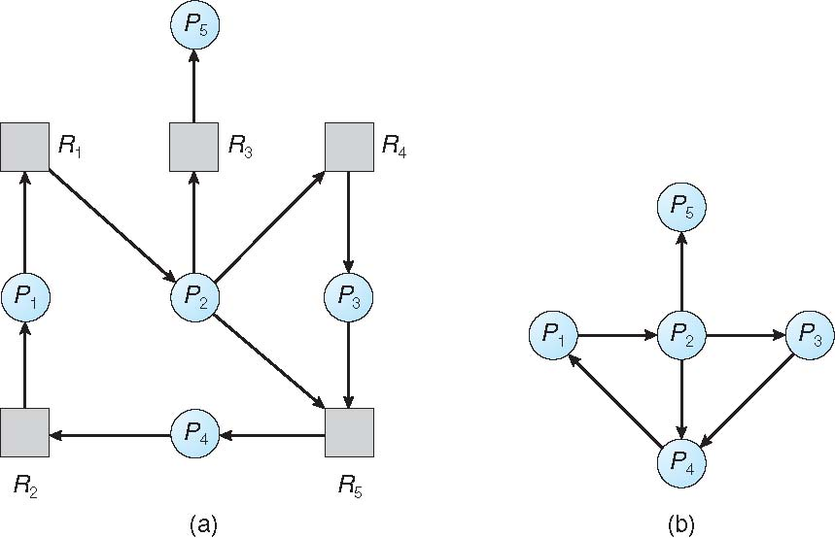
Resource-Allocation Graph and Wait-for Graph
Resource-Allocation Graph
Corresponding wait-for graph

Slide 39
Several Instances of a Resource Type
Available: A vector of length m indicates the number of available resources of each type.
Allocation: An n x m matrix defines the number of resources of each type currently allocated to each process.
Request: An n x m matrix indicates the current request of each process. If Request [i][j] = k, then process P_{i} is requesting k more instances of resource type.R_{j}.

Slide 40
Detection Algorithm
Let Current_Avail and Marked be vectors of length m and n, respectively.
Safe string is an array to store the process IDs
Current_Avail = Available
Initialize Marked as:
for(i=1;i<=n ; i++)
Marked[i]=False;
3. Find a process Pi such that
Request_{i} <=Current_Avail and Marked[i]=False
4. If(found)
{
Current_Avail=Current_Avail + Allocation_{i}
Marked[i]= true
Save the process number in safestring[]
go to step 3
}
5. If (Marked[i]==true) for all processes, then the system is not in deadlocked state
Print Safe string
Otherwise, the system is in deadlock caused by process Pi

Slide 41
Example of Detection Algorithm
Five processes P1 through P5; three resource types R1 (5 instances), R2 (6 instances), and R3 (4 instances)
Snapshot at time T₀:
Allocation Request Available
A B C A B C A B C
P1 1 0 2 1 0 0 ? ? ?
P₂ 1 1 0 4 0 2
P₃ 1 1 0 0 1 2
P₄ 0 2 1 2 1 0
P₅ 1 2 0 3 1 4
Determine whether the system is in deadlock situation ?

Slide 42
Example (Cont.)
P4 requests an additional instance of type R2
Find out whether the system is in a deadlock state.

Slide 43
Detection-Algorithm Usage
Deadlock detection is a costly algorithm to implement, due to cost of detecting state of system and affects system performance as well
How often the algorithm should be run to detect deadlock?
It would be a good solution if detection algorithm is invoked , every time a process requests for a resource
Detection algorithm checks which process caused the deadlock.
However, this solution is expensive, as it increases the overhead of computation time

Slide 44
Recovery from Deadlock: Process Termination
Abort all deadlocked processes
Abort one process at a time until the deadlock cycle is eliminated
In which order should we choose to abort?
Priority of the process
How long process has computed, and how much longer to completion
Resources the process has used
Resources process needs to complete
How many processes will need to be terminated
Is process interactive or batch?

Slide 45
Recovery from Deadlock: Resource Preemption
If preemption is required to deal with deadlocks, then 3
issues need to be addressed :
Selecting a victim – minimize cost
Rollback – return to some safe state, restart process from that state
Problem: Starvation – same process may always be picked as victim,

